Slide 1

SODA SALES ANALYSIS
(MMM)
By. ROHIT SINGH

Slide 2
SECTION 1
📊 Sales Analysis of a Soft Drink Brand
📅Data spans from January 2012 to September 2015 with monthly time-series data
STATISTICAL MODELLING
MEDIA ANALYSIS
COMPETITOR ANALYSIS
OTHERS
Understanding correlations and causations using statistical models
Identify impactful media channels and promotions
Understanding the role of competitor advertising activities
Look for Seasonality, Trend, and Transform TV_Grp to Adstock

Slide 3
DATASET
🧪 Variables:
▸ Month – Month of activity
Target Variable:
▸ SalesVol – Sales in litres
Marketing Inputs:
▸ TVGRP, InstoreAds, OutdoorAds, Promotions, DigitalAds
Price Factor:
▸ Price – Average price per 10 litres
Competitive Spend:
▸ Comp1TV, Comp1NP, Comp2OOH, Comp2NP
SodaSales

Slide 4

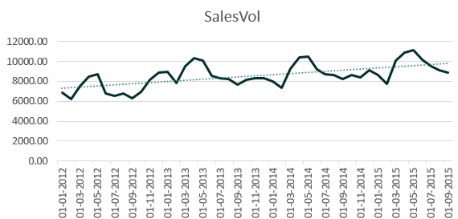
SEASONALITY
Seasonality period - 12 months
12monthLag_Sales variable
CORRELATION (SalesVol, 12monthLag_Sales) = 0.77
R2 SCORE = 59%
www.reallygreatsite.com

Slide 5
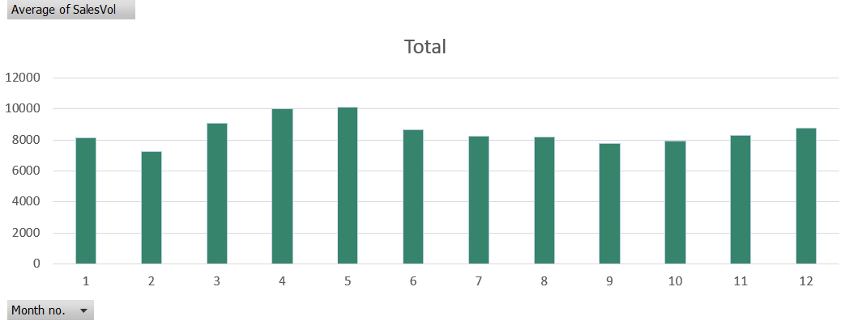
SEASONALITY
Peak sales are in April- May, i.e peak summer months, and lowest sales in February.

Slide 6
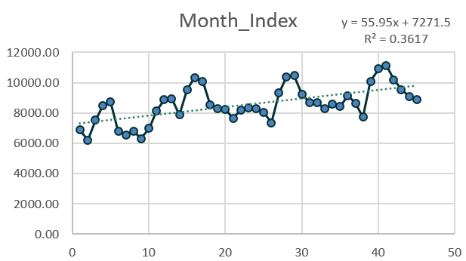
TREND
Since slope of trend line is 55L per month, i.e >0. Hence, there is a trend in the SalesVol.
Michelle
@reallygreatsite
www.reallygreatsite.com

Slide 7

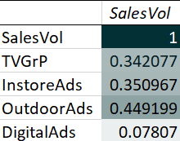
ADVERTISING MEDIA ANALYSIS
TVGrp- Moderate positive- reach still matters
InstoreAds - Comparable to TV
OutdoorAds- Strongest-most effective - R2 = 20%
DigitalAds- Very weak; digital spend hasn’t yet translated into volume
@reallygreatsite
www.reallygreatsite.com

Slide 8
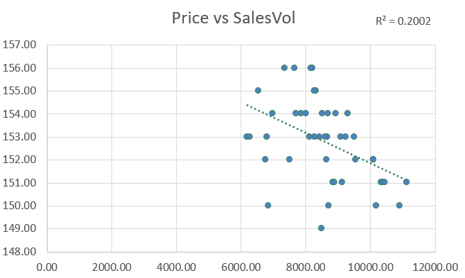
PRICE VS SALES
CORRELATION (SalesVol, Price) = -0.44742 (Strong Negative Correlation)
R2 Score = 20%

Slide 9
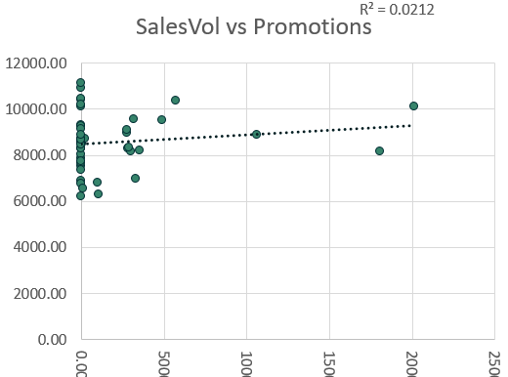
SALES VS PROMOTIONS
CORRELATION (SalesVol, Promotion) = 0.1457 (Weak Positive Correlation)
R2 Score = 2.12%

Slide 10
SALES VS PROMOTIONS
Partial Correlation - TV/Instore/Outdoor/Digital partialled out
PARTIAL CORRELATION (Sales, Promotion) = 0.1298 (after removing the four media effects)
After removing the four media effects, partial r ≈ +0.13. → a small positive link remains, so promotions work independently but are not the primary volume driver.

Slide 11
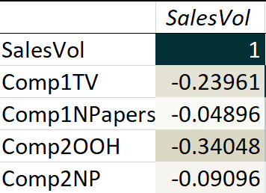
ADVERTISING MEDIA ANALYSIS
The strongest (negative) association is Competitor 2’s outdoor advertising; followed by the Competitor 1's TV advertising.
Note: Competitor 2's Outdoor advertising affect our sales the most - but, Comp2OOH spends happens only twice, so there could possibly be some redundancy in the data.
@reallygreatsite
www.reallygreatsite.com

Slide 12

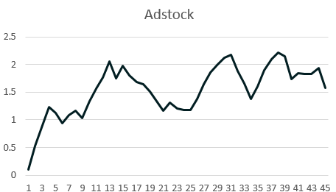
ADSTOCK
0 ≤ L ≤ 1 ; carry over effect : L=0.7 (70% of adstock from the previous month is retained in the current month)
n > 0 ; (n=2)
k > 0 ; (k=1000)
www.reallygreatsite.com

Slide 13

Seasonality : 0.77 (Strong Positive Correlation)
Trend with slope : 55L per month
Correlation (SalesVol, Media) :
TV : 0.342
Instore Ads : 0.3501
OutdoorAds : 0.4492 (Strongest)
Digital : 0.0781 (Weakest)
Correlation (SalesVol, Price) : -0.4474 (Strong Negative)
Correlation (SalesVol, Promotion) : 0.1457
PARTIAL CORRELATION (Sales, Promotion) = 0.1298 (after removing the four media effects)
Competitor Media effect:
Competitor 2's OOH : Correlation = -0.34048
Competitor 1's TV : Correlation = -0.23961
SUMMARY

Slide 14
STRATEGIC RECOMMENDATIONS
Ramp up marketing before seasonal peaks.
Trend >0 —investment in expansion is justified.
DigitalAds media needs a review.
Price is negatively correlated with Sales Volume. A reduction could boost demand.
Promotions affect sales, independent of advertising, Continue!
Outdoor ads by Competitor 1 most strongly cannibalize our volumes, need strategy.
Use Adstock in media models to reflect actual impact better than raw GRP.

Slide 15


Thank you
+91-9173948488
iamrohitsingh0val@gmail.com

